Slide 1



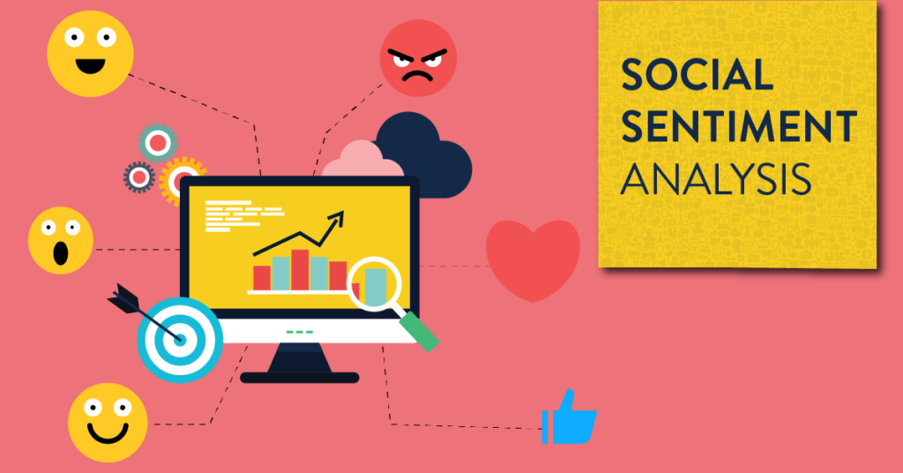
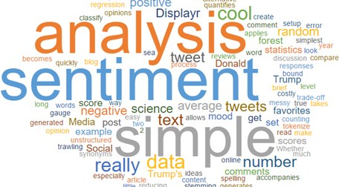
Enterprise AI
“Your most unhappy customers are your greatest source of learning.” — Bill Gates

Slide 2

About Me
Name :Suman Rakshit
ID :CT20203317618
Collage : Jadavpur University
github.com/sumanrakshithub.com/sumanrakshitgith

Slide 3
Problem Statement
With Superior Customer Experience of paramount importance for all business operations, it has become imperative to treat this process with utmost care infused with latest AI/ML technologies. It is expected to drive the customer experience to a new level of awareness and acceptance. The sea of technologies changes, have also brought to the table, newer and better aspects towards our customer experience. These customers include the internal as well as external customers.

Slide 4
Technologies To Be Used
• Hardware requirements:
• Processor: Intel dual core or above
• Processor Speed:1.0GHZ or above
o RAM: 1 GB RAM or above
o Hard Disk: 20 GB hard disk or above
• Software requirements:
• Front End: HTML, CSS, JAVASCRIPT.
• Back End: Flask
• Database: SQLAlchemy, MySQL

Slide 5
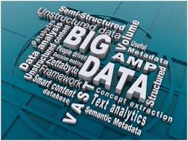

Structure and unstructured
21 % data structure

Slide 6
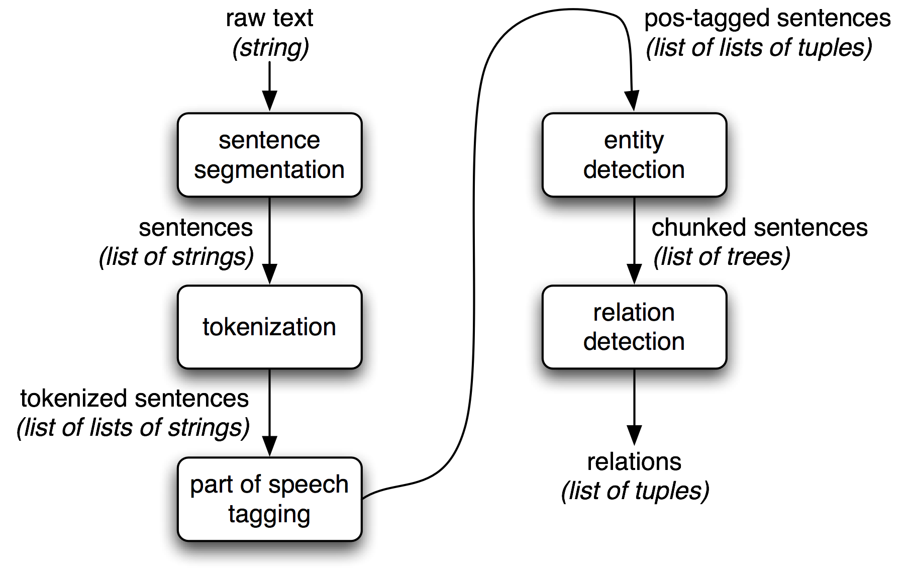
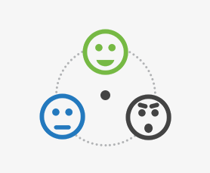
Architecture

Slide 7
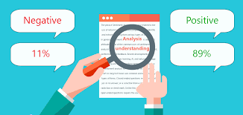
What is Sentiment Analysis?
Sentiment analysis is a type of data mining that measures the inclination of people’s opinions through natural language processing (NLP), computational linguistics and text analysis, which are used to extract and analyze subjective information from the Web — mostly social media and similar sources. The analyzed data quantifies the general public’s sentiments or reactions toward certain products, people or ideas and reveal the contextual polarity of the information. Sentiment analysis is also known as opinion mining.

Slide 8

What is Text Mining?
Text mining (also known as text analysis), is the process of transforming unstructured text into structured data for easy analysis. Text mining uses natural language processing (NLP), allowing machines to understand the human language and process it automatically.

Slide 9
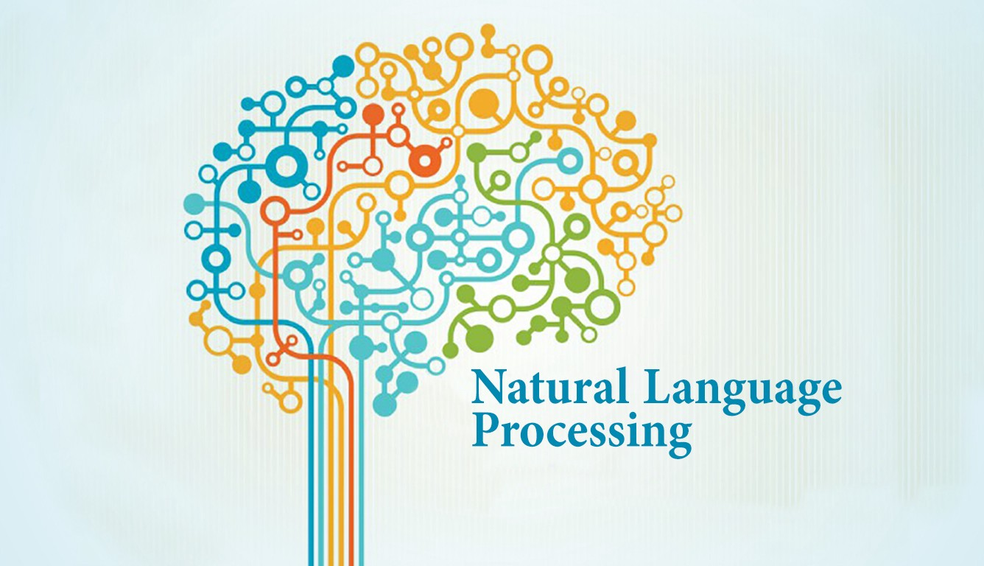
NLP
Natural Language Processing (NLP) is the part of AI that studies how machines interact with human language. ... Combined with machine learning algorithms, NLP creates systems that learn to perform tasks on their own and get better through experience.

Slide 10
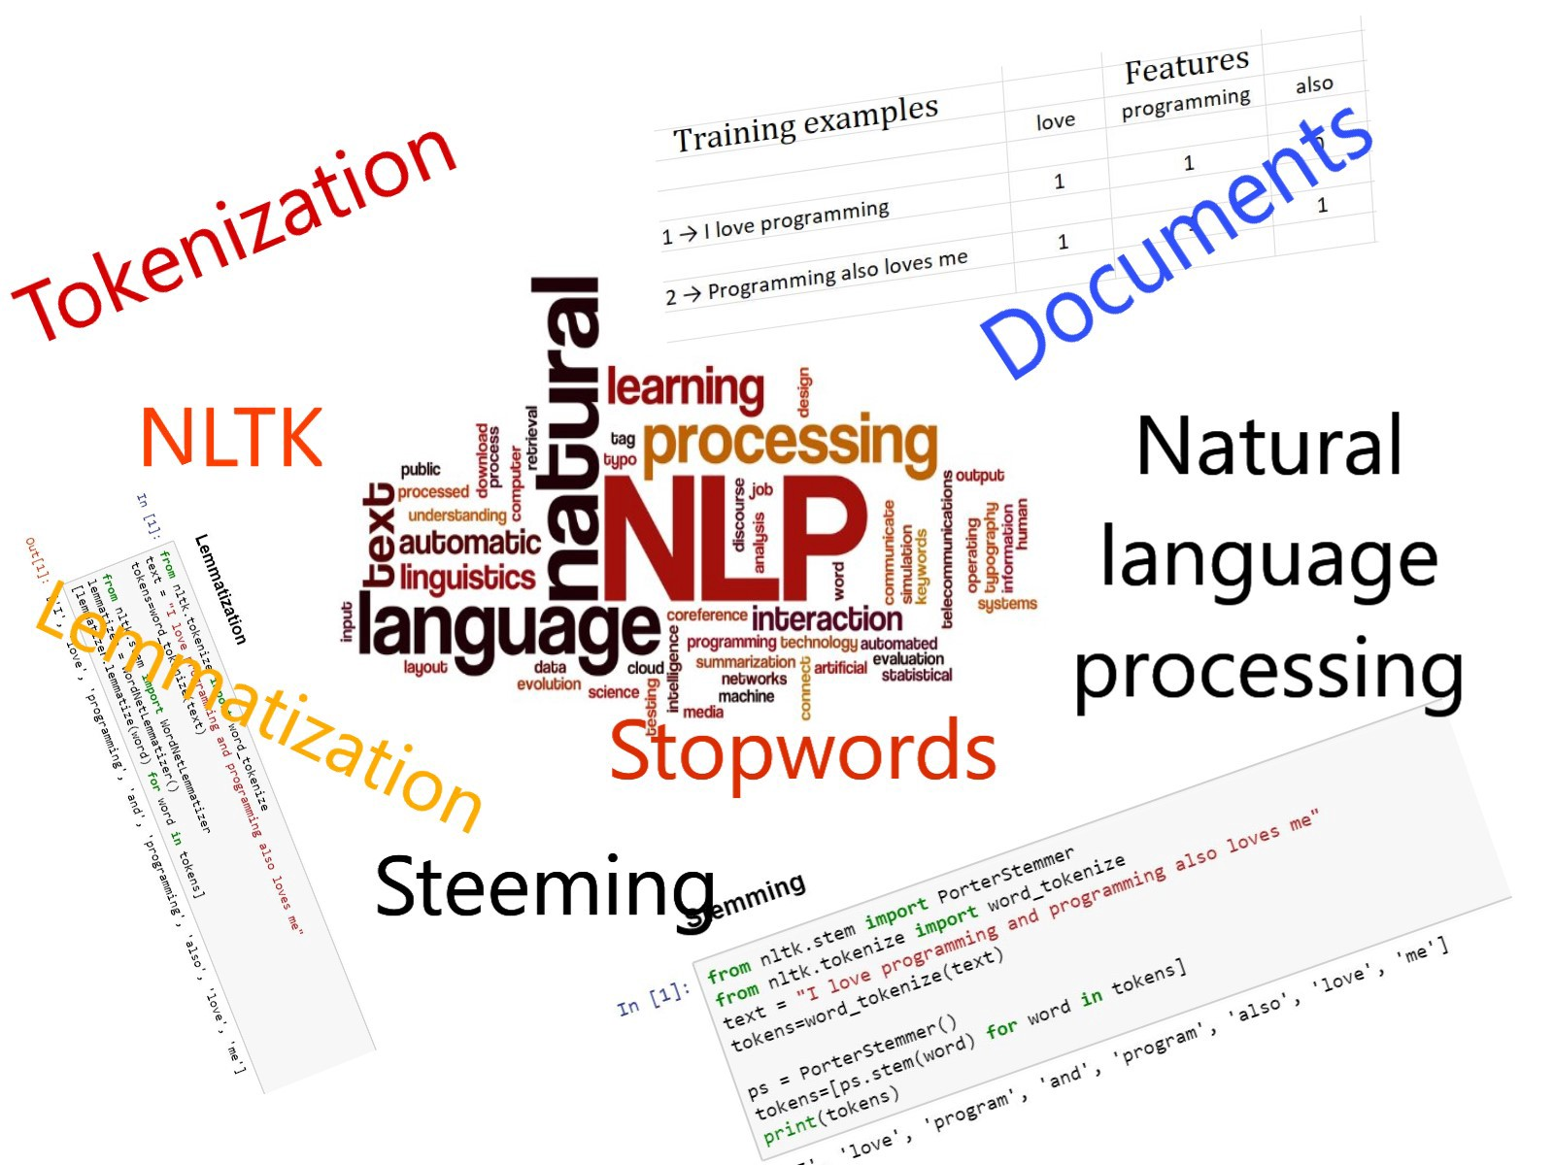
NLTK
NLTK is a leading platform for building Python programs to work with human language data. It provides easy-to-use interfaces to over 50 corpora and lexical resources such as Word Net, along with a suite of text processing libraries for classification, tokenization, stemming, tagging, parsing, and semantic reasoning, wrappers for industrial-strength NLP libraries, and an active discussion forum.

Slide 11
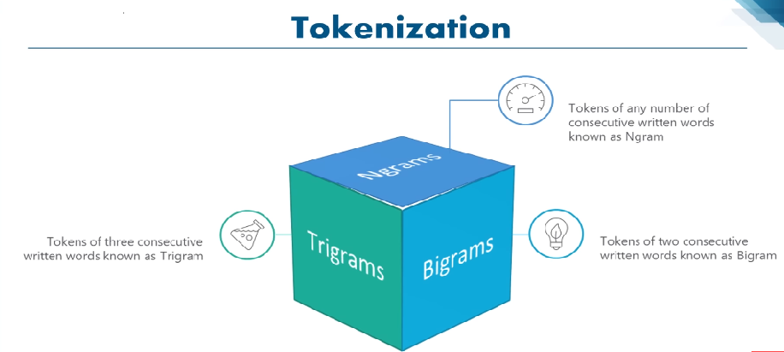
Tokenization
Tokenization is the process by which big quantity of text is divided into smaller parts called tokens.
Natural language processing is used for building applications such as Text classification, intelligent chatbot, sentimental analysis, language translation, etc. It becomes vital to understand the pattern in the text to achieve the above-stated purpose. These tokens are very useful for finding such patterns as well as is considered as a base step for stemming and lemmatization.

Slide 12
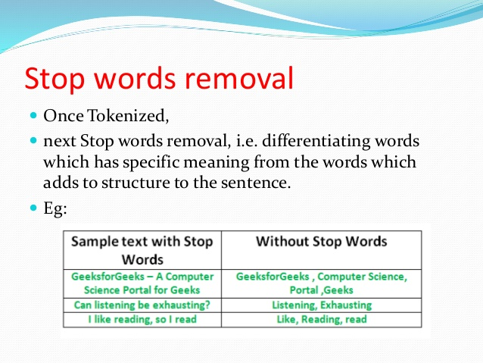
Removing stop words with NLTK in Python
The process of converting data to something a computer can understand is referred to as pre-processing. One of the major forms of pre-processing is to filter out useless data. In natural language processing, useless words (data), are referred to as stop words.

Slide 13
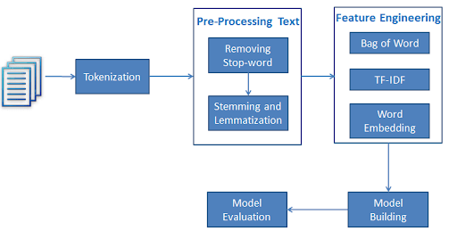
How To Work

Slide 14
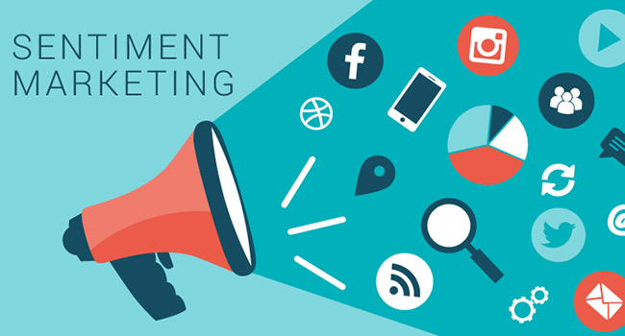
Future Use
The future of sentiment analysis is going to continue to dig deeper, far past the surface of the number of likes, comments and shares, and aim to reach, and truly understand, the significance of social media interactions and what they tell us about the consumers behind the screens. This forecast also predicts broader applications for sentiment analysis – brands will continue to leverage this tool, but so will individuals in the public eye, governments, nonprofits, education centers and many other organizations.

Slide 15

Conclusion
Enterprise AI is a uniquely powerful tool for businesses that are looking to measure attitudes, feelings and emotions regarding their brand. To date, the majority of sentiment analysis projects have been conducted almost exclusively by companies and brands through the use of social media data, survey responses and other hubs of user-generated content. By investigating and analyzing customer sentiments, these brands are able to get an inside look at consumer behaviors and, ultimately, better serve their audiences with the products, services and experiences offer to the customer .

Slide 16

THANK YOU

